Slide 1
proposed store layout
Student Name
The proposed store is designed to meet the customer’s specifications. On the current fashion trends. The store should have eye-catching cloths to meet the customer’s demand.

Slide 2
Our mission
The primary vision is to provide a world class products that fits our clients. We are tailored towards providing captivating cloths that are on the current trends and suits our customer’s needs.

Slide 3
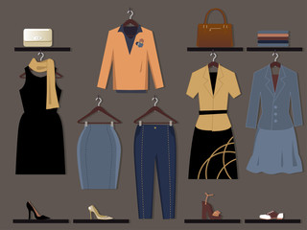

Slide 4
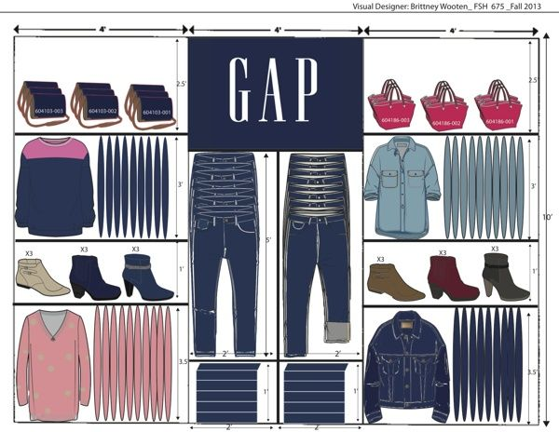

Slide 5
Who are our target customers
Our business targets the youths of all categories. We have cloths that fills their satisfactory to the fullest. We have men’s suits and ladies suits too. Our store is spacious to accommodate different varieties of cloths. It has a fitting room where one tries whether the cloths fits him/her. Come one come all. Welcome to the Ladies and Gents Fashion.

Slide 6
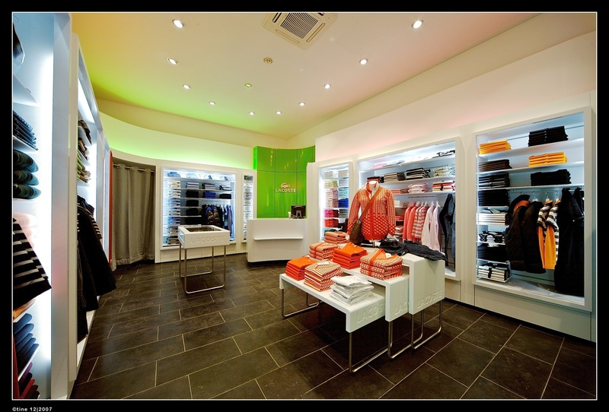

Slide 7
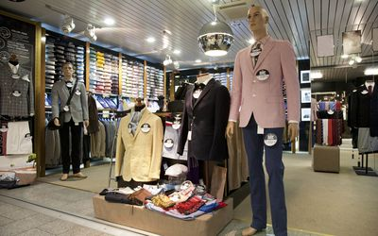

Slide 8
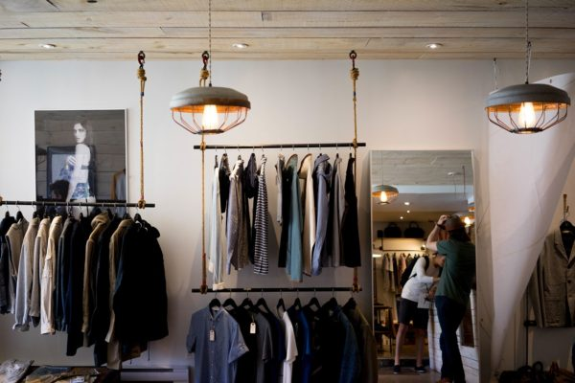

Slide 9
